Slide 1



MIDTERM REVIEW
Eva Evgenieva
Fontys University of Applied Science

Slide 2
01.
INTRODUCTION TO THE COMPANY
02.
ASSIGNMENT OVERVIEW
03.
CHALLENGES & SOLUTIONS
TABLE OF
CONTENTS
04.
RESEARCH & METHODS
05.
TIMELINE & PHASES
06.
FUTURE STEPS AND Q&A

Slide 3

01.
INTRODUCTION TO THE COMPANY

Slide 4
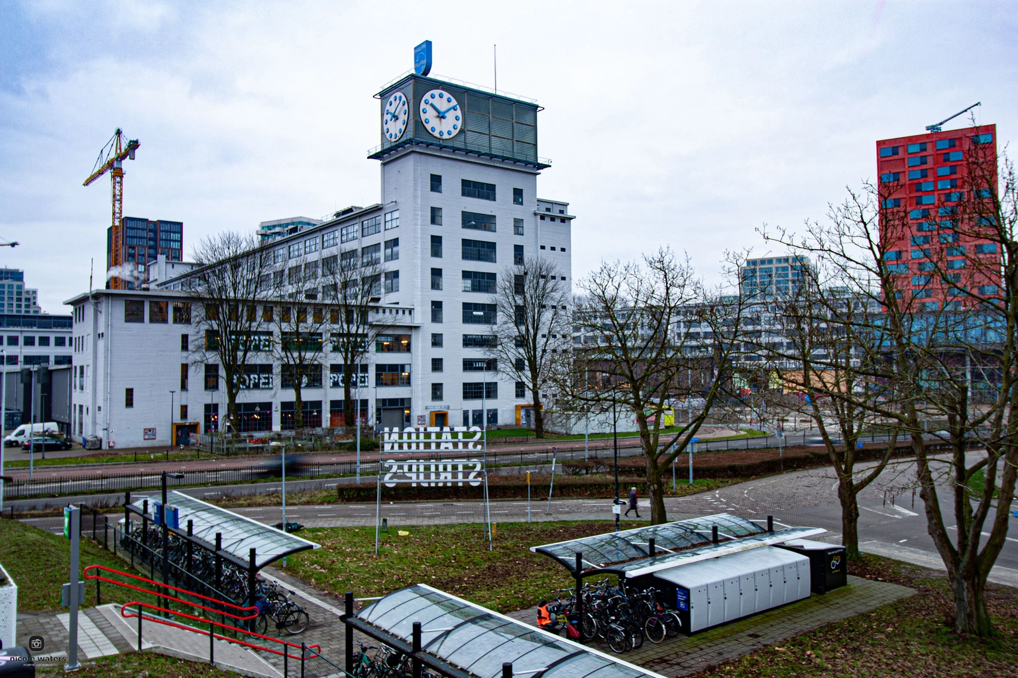

COMPANY OVERVIEW
Tada Solutions specializes in data management and analytics, focusing on enhancing data accessibility and user engagement through advanced visualization techniques in their PowerBI platform. The company is committed to transforming complex data into actionable insights.
Notes:
Tada Solutions is an IT company specialising in data management and analytics
it is known for converting complex data into actionable insights
the company provides advanced services to help businesses make the most out of their data
there are some advancements in data integration and user-friendly reporting to help users get up-to-date information

Slide 5
02.
ASSIGNMENT
OVERVIEW

Slide 6
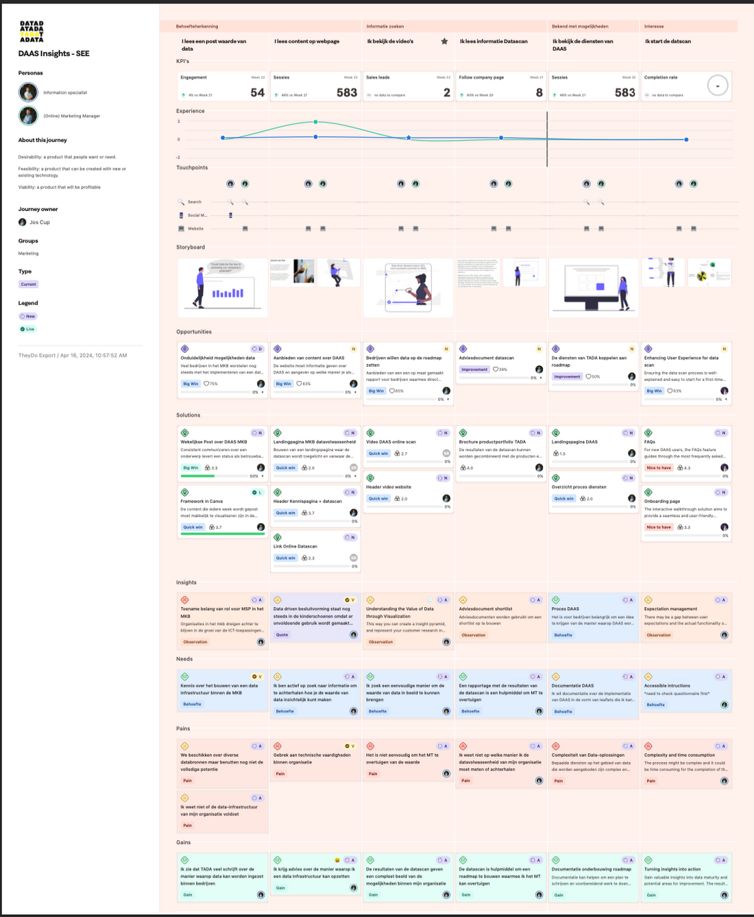
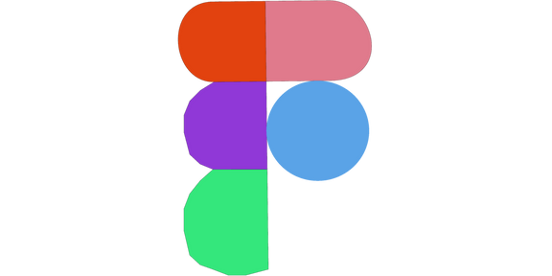

ASSIGNMENT
The goal is to create interactive, engaging customer journey map design that will simplify complex business processes, increasing user and client satisfaction
Notes:
the goal is to find new ways to visually show and improve how customer journeys and business processes are understood by clients
this will make them easier for everyone to follow and use
this involves creating clearer and more engaging designs to help users make better decisions and interact more effectively with business operations
The project aims to enhance interaction design and data visualization, focusing on user-friendly interfaces for data analysis diagrams and innovative visualization methods
deliverables include high-fidelity prototypes and a research document, utilizing Figma and possibly PowerBI
the project emphasizes an intuitive and enjoyable user experience in data exploration
if there is enough time for the main task, I will do some front-end coding based on my prototype

Slide 7
03.
CHALLENGES &
SOLUTIONS

Slide 8
SOLUTIONS
Innovative visualization techniques
Interface design improvements
Starting the design from scratch, then ask for feedback
Research topics thoroughly
CHALLENGES
Lack of engaging design in analytics tools
Complexity in data interpretation
Lack of design inspirations
The way of putting the information in the customer journey map
Not enough conducted research on the topic

Slide 9
04.
RESEARCH &
METHODS

Slide 10
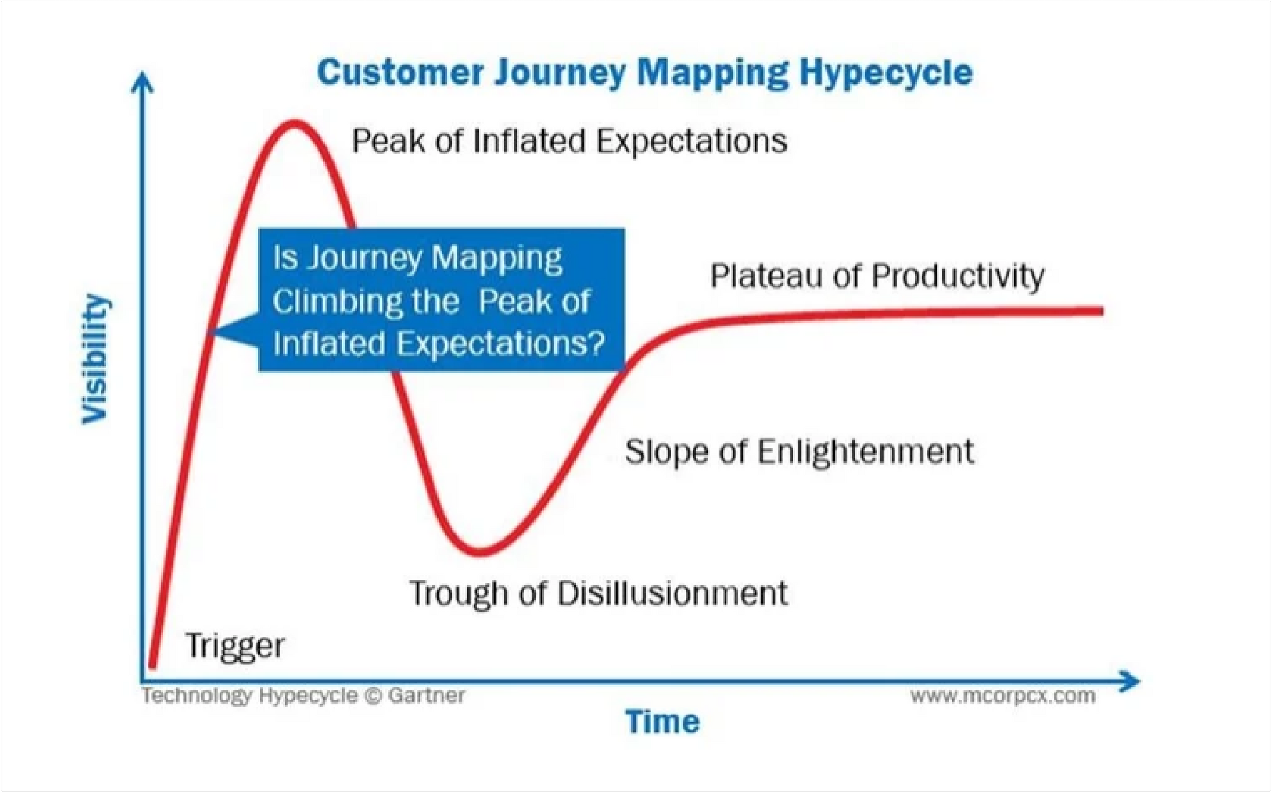
RESEARCH
Research questions
Initial background research
Applied research
Google Trends
Gartner’s hypecycle
Stages of customer journey mapping
METHODS
Interviews (1 expert, 1 student)
Empathy map
Persona
Literature review

Slide 11
05.
TIMELINE AND PHASES

Slide 12



Market analysis
Industry CJM
Interactive design
Customer interaction to business processes
Customer behavior data
PLAN
DESIGN
TEST
RESEARCH
DEVELOP
EVALUATE
Define scope and objectives
Write project plan
Create project timeline
Customer journey map drafts
Interactive elements in prototype
Design iterations & feedback
Notes:
In the next phase which is develop, I will create high-fidelity prototype
In the testing phase, I will conduct user testing with different types of users such as a non-IT person, existing client of the company and a business student,
also I will adjust the design as needed
In the evaluation phase I will analyse the feedback, identify areas for improvement and document the findings, as well as writing my portfolio document

Slide 13
06.
FUTURE STEPS
Q&A

Slide 14
Q&A
FUTURE STEPS
Iterations on the design
Development on chosen design
User testing
High-fidelity prototype
If there is enough time,
code the Figma design
Portfolio website / document
Areas for improvement

Slide 15
THANK YOU FOR YOUR ATTENTION!

